Slide 1
MRA Project - Milestone 2
1

Slide 2
CONTENTS OF PRESENTATION
Description of the content | Slide No’s
1. Exploratory Analysis | 3-15
2. Use of Market Basket Analysis (Association Rules) | 16-22
3. Associations Identified | 23-29
4. Suggestion of Possible Combos with Lucrative Offers | 30-34
CONCLUSIONS | 35

Slide 3
Exploratory Analysis
→Exploratory Analysis of data & an executive summary (in PPT) of your top findings, supported by graphs.
→Trends across months/years/quarters/days etc

Slide 4
PROBLEM STATEMENT
A Grocery Store shared the transactional data with you. Your job is to identify the most popular combos that can be suggested to the Grocery Store chain after a thorough analysis of the most commonly occurring sets of items in the customer orders. The
Store doesn’t have any combo offers. Can you suggest the best combos & offers?
The project involves conducting a thorough analysis of Point of Sale (POS) Data for providing recommendations through which a grocery store can increase its revenue by popular combo offers & discounts for customers.
4

Slide 5
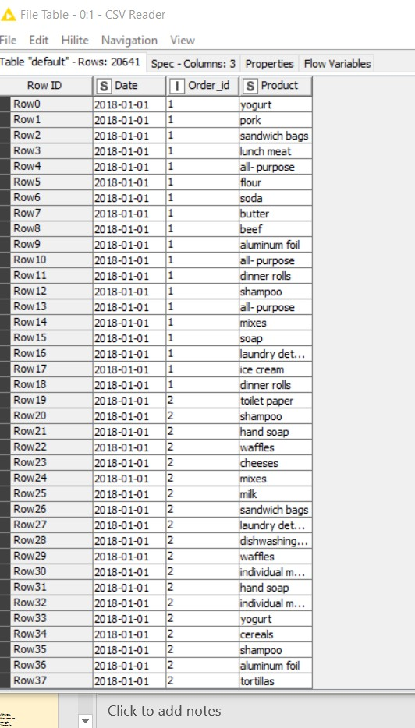
EXPLORATORY ANALYSIS
Read the dataset of Grocery Store
Data: dataset_group.csv in KNIME using csv reader node.
INFERENCE:
Data set consists of three column varibles viz., Date, Order_id and Product with 20640 rows apart from header.
Date: depicts the date on which different orders were transacted.
Order_id: purchased identification done on
different dates.
Product: Products purchased .

Slide 6
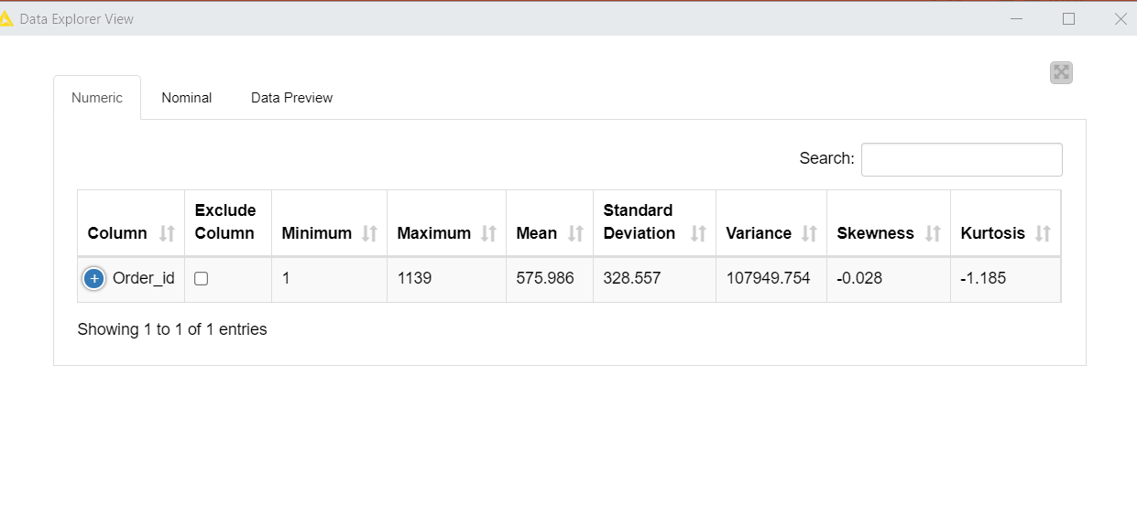
EXPLORATORY ANALYSIS
THERE ARE 1139 ORDERS WITH IDS 1 TO 1139 FOR DIFFERENT PRODUCT TRANSACTIONS
Output generated in knime using dataexplorer node connected to the csv reader node.

Slide 7
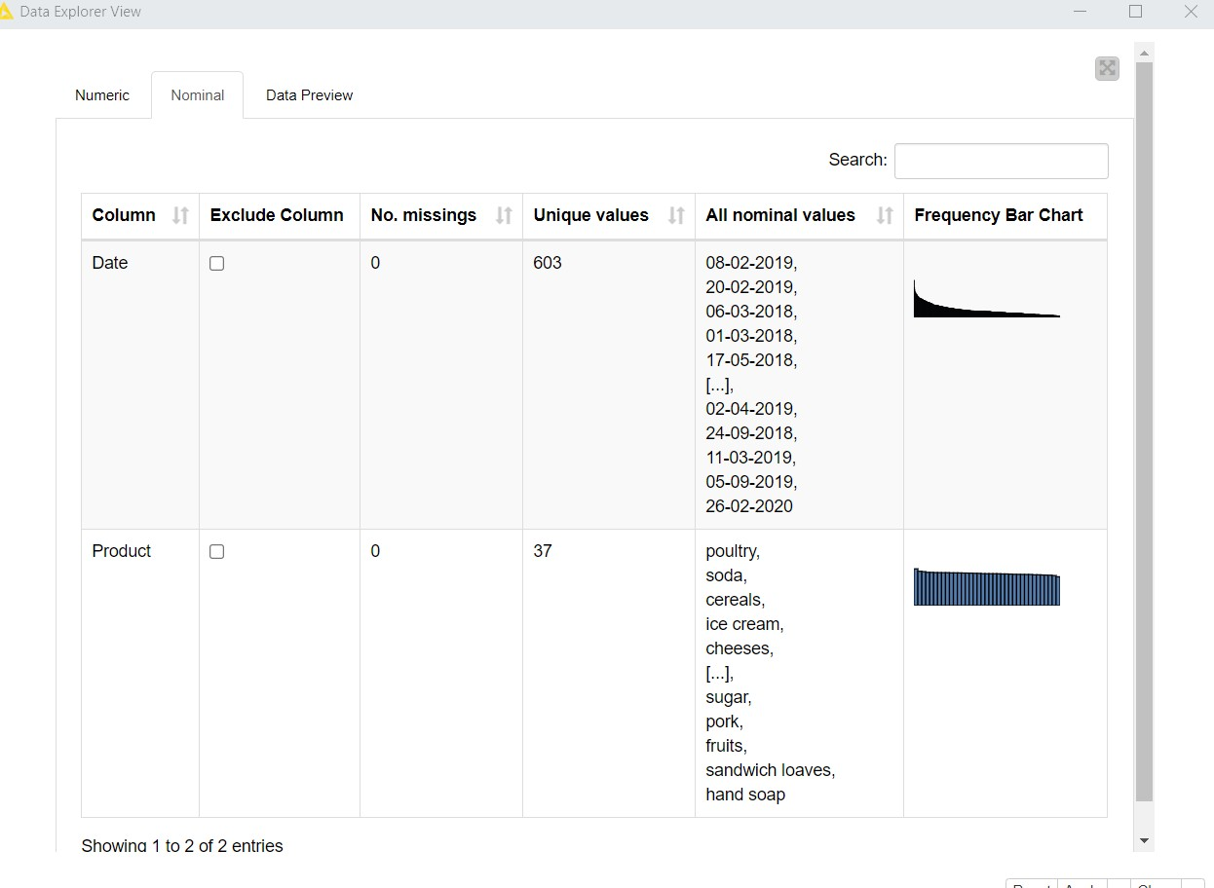
EXPLORATORY ANALYSIS
THERE ARE 1139 ORDERS TRANSACTED ON 603 UNIQUE DATES FOR 37 DIFFERENT PRODUCTS.
Output generated in knime using dataexplorer node connected to the csv reader node.

Slide 8
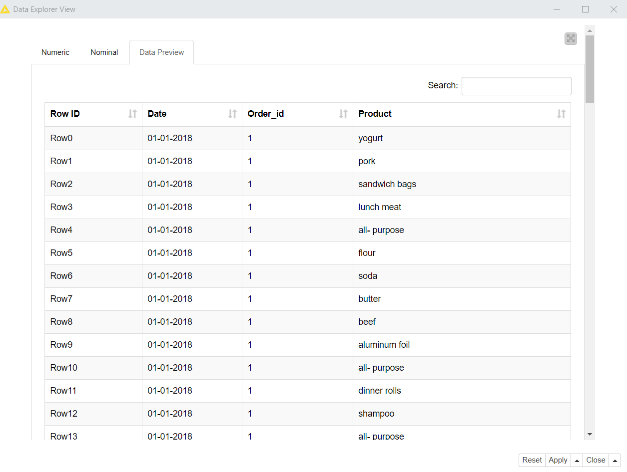
EXPLORATORY ANALYSIS
Output generated in knime using dataexplorer node connected to the csv reader node.

Slide 9
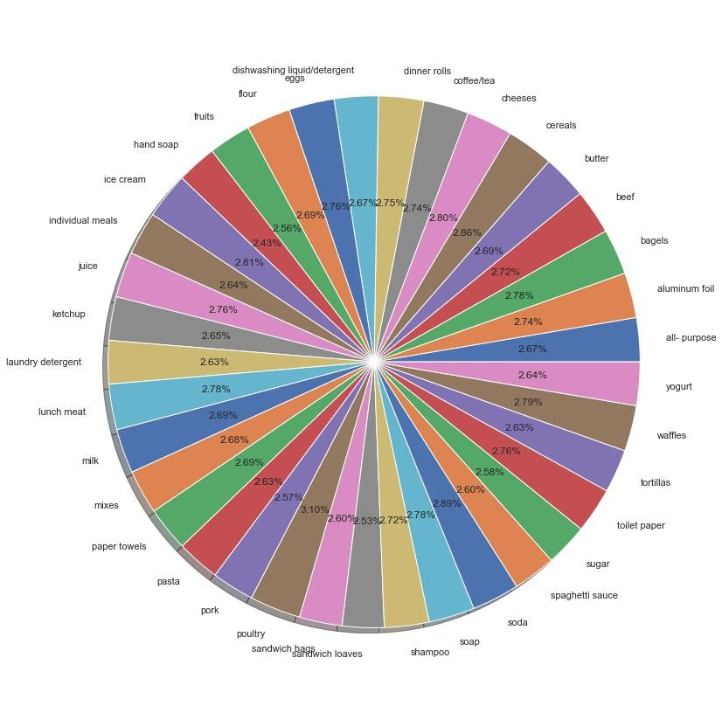
EXPLORATORY ANALYSIS
SALES PERCENTAGE
The piechart denotes the percentage of sales of each product over a span of 3 years.
Highest percentage of sales: Poultry (3.10%)
Lowest percentage of sales: Hand soap (2.43%)
Plots generated in python jupyter notebook after reading the csv files and importing libraries pandas, matplotlib and seaborn

Slide 10
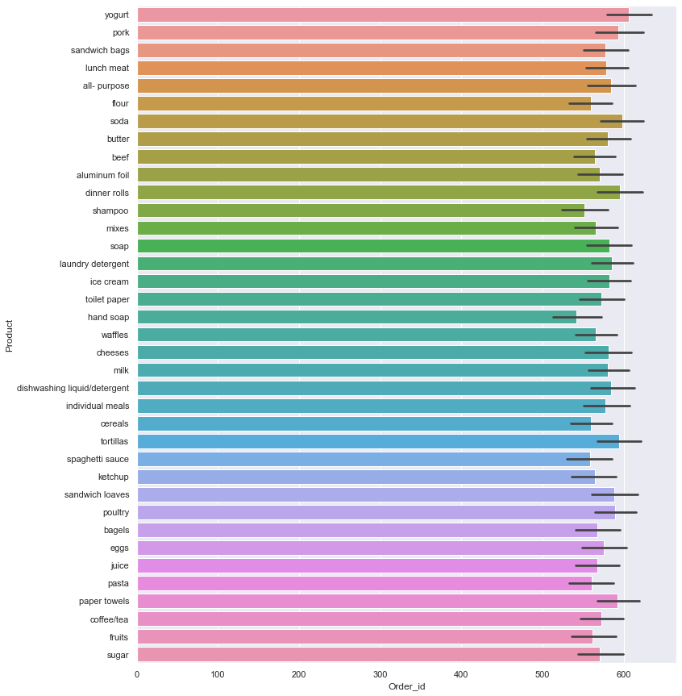
EXPLORATORY ANALYSIS
The barplot denotes the frequency of each product sold in 3 years.
The maximum no.of items sold are poultry product and least sold products are hand soaps.
Plots generated in python jupyter notebook after reading the csv files and importing libraries pandas, matplotlib and seaborn

Slide 11
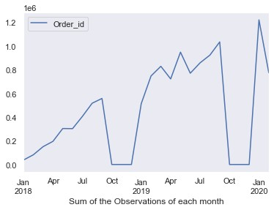
MONTHLY SALES TREND
# The sales increase till Jul and rapidly decrease by October.
The most profitable month is August.
# The least profitable months are October, November and December.
Plots generated in python jupyter notebook after reading the csv files and importing libraries pandas, matplotlib and seaborn

Slide 12
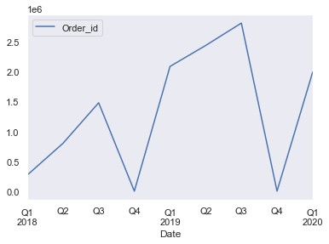
QUARTERLY SALES TREND
#The sales follow decreasing trend in Q4.
#Sales increase in Q1 and Q2 but the net effect considering all the quarters is still a loss in sales for the company in Q4 .
Plots generated in python jupyter notebook after reading the csv files and importing libraries pandas, matplotlib and seaborn

Slide 13
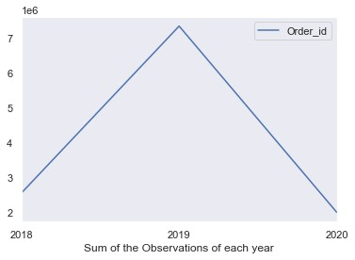
YEARLY SALES TREND
# It is observed that sales are maximum in 2019 and sales drop drastically by 2020. #So, market basket analysis of data may provide recommendations for higher profits.
Plots generated in python jupyter notebook after reading the csv files and importing libraries pandas, matplotlib and seaborn

Slide 14
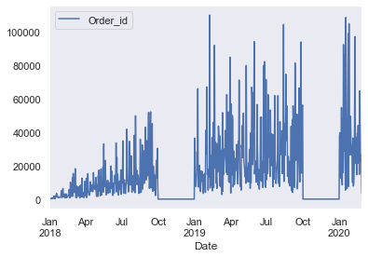
DAILY SALES TREND
#In 2018, there was a rapid decline in sales.
# From 2019 daily sales got increased compared to 2018.
Plots generated in python jupyter notebook after reading the csv files and importing libraries pandas, matplotlib and seaborn

Slide 15
EXECUTIVE SUMMARY OF EXPLORATORY ANALYSIS
Data set consists of three column varibles viz., Date, Order_id and Product with 20640 rows apart from header.
There are 1139 orders transacted on 603 unique dates for 37 different products.
The sales increase till Jul and rapidly decrease by October. The most profitable month is August.
The least profitable months are October, November and December.
It is observed that sales are maximum in 2019 and sales drop drastically by 2020.
So, market basket analysis of data may provide recommendations for higher profits.

Slide 16
Use of Market Basket Analysis (Association Rules)
-->Write Something about the association rules and its relevance in this case
-->Add KNIME workflow Image or Python package used
-->Write about threshold values of Support and Confidence

Slide 17
ASSOCIATION RULES:
Association rules are actionable and can be used to target customers for marketing or for placing different products or more generally to inform decision making.
They are used to give insights into other products the customer is likely to purchase.
For supermarket purchases, association rules can be utilized for knowing common combinations of products, wherein the information can be utilized for product placement on supermarket shelves.
RELEVANCE OF ASSOCIATION RULES:
Association rules are a method of unsupervised learning
Association rules find all the set of items having support greater than the minimum support and then using the large item sets to generate the desired rules that have confidence greater than minimum confidence

Slide 18
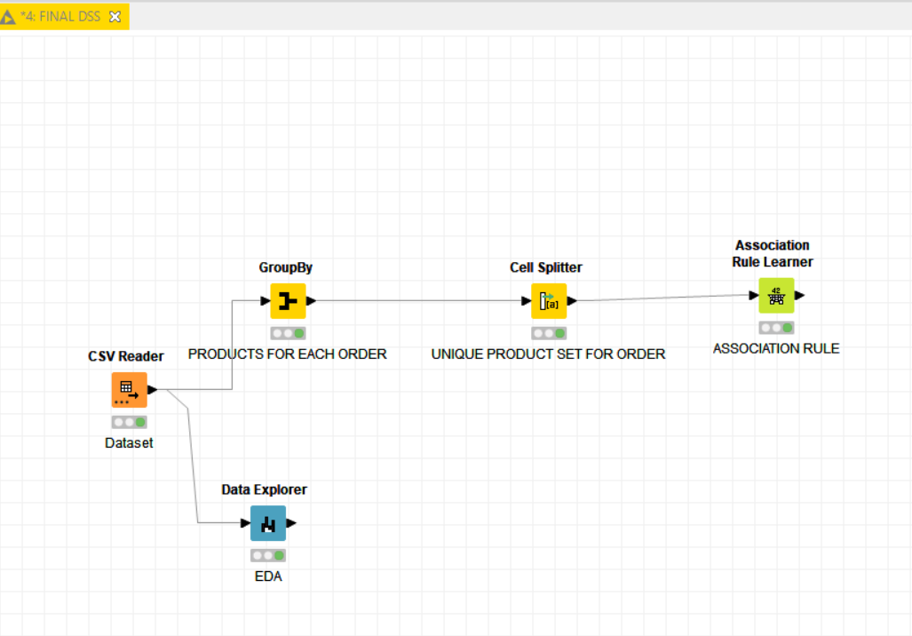
KNIME WORKFLOW IMAGE FOR MARKET BASKET ANALYSIS (ASSOCIATION RULES)

Slide 19
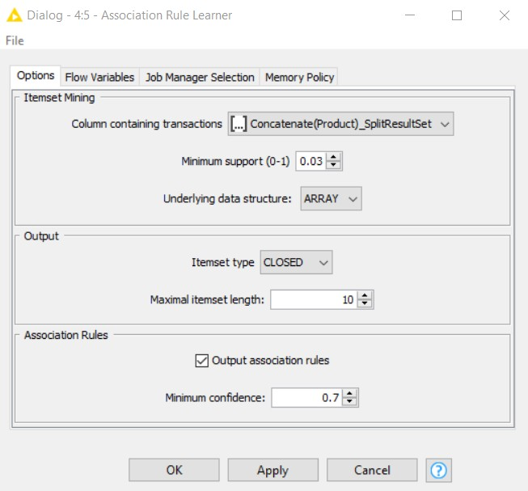
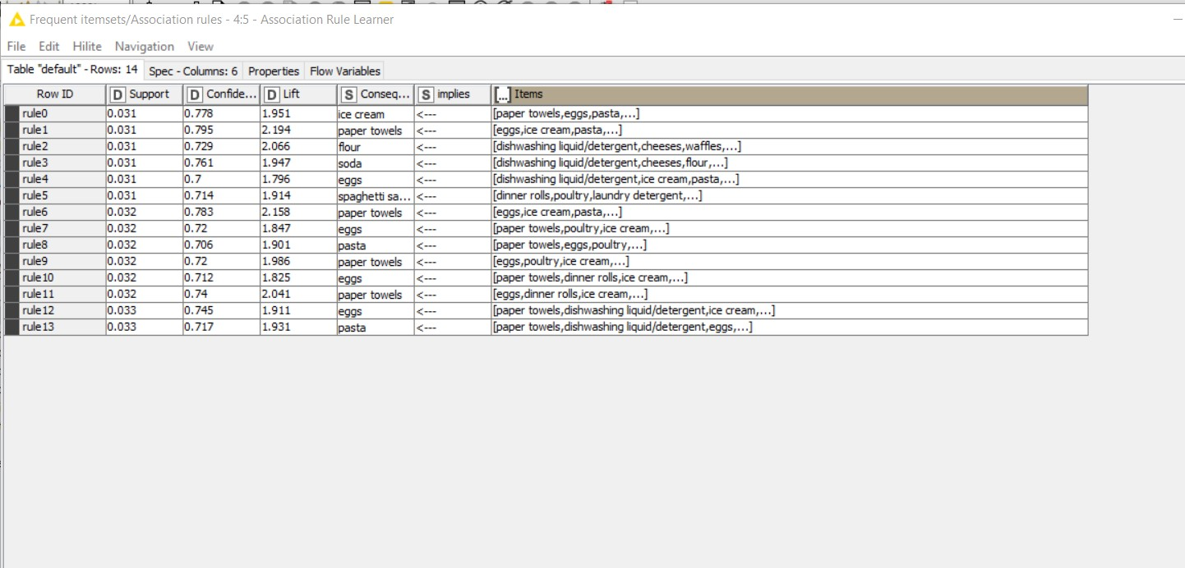
MARKET BASKET ANALYSIS (ASSOCIATION RULES)
THRESHOLD VALUES
SUPPORT: 3% AND CONFIDENCE: 70%, WE COULD GET 14 PATTERNS OR BASKETS WITH
LIFT 2.194 ITEMS

Slide 20
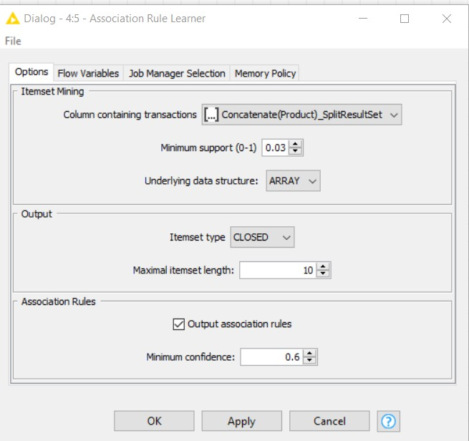
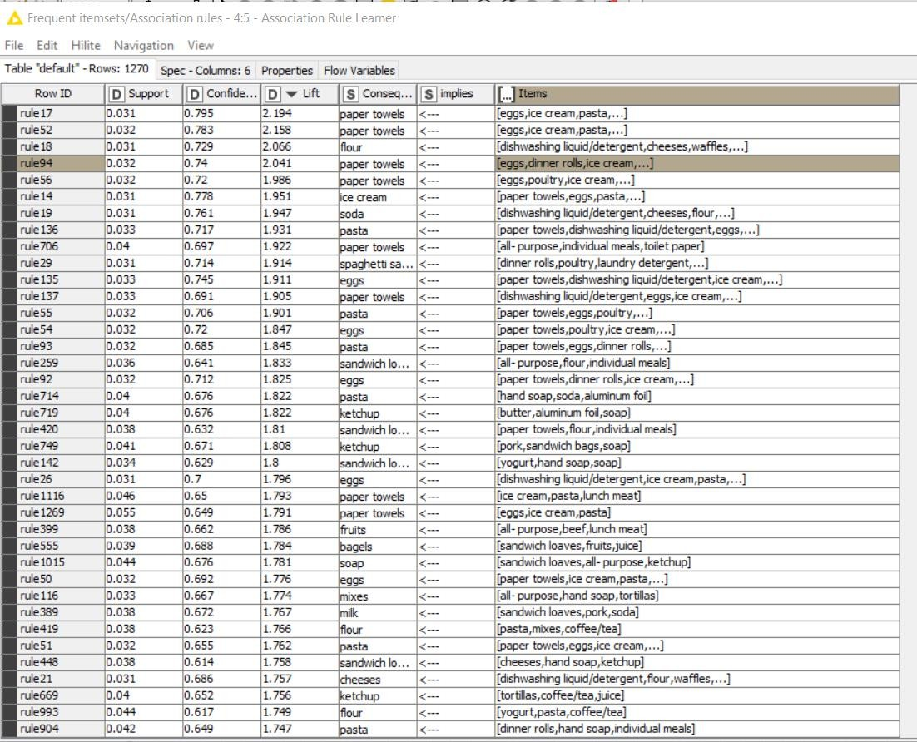
MARKET BASKET ANALYSIS (ASSOCIATION RULES)
THRESHOLD VALUES
SUPPORT: 3% AND CONFIDENCE: 60%, WE COULD GET 1270 PATTERNS OR BASKETS WITH LIFT 2.194 ITEMS

Slide 21
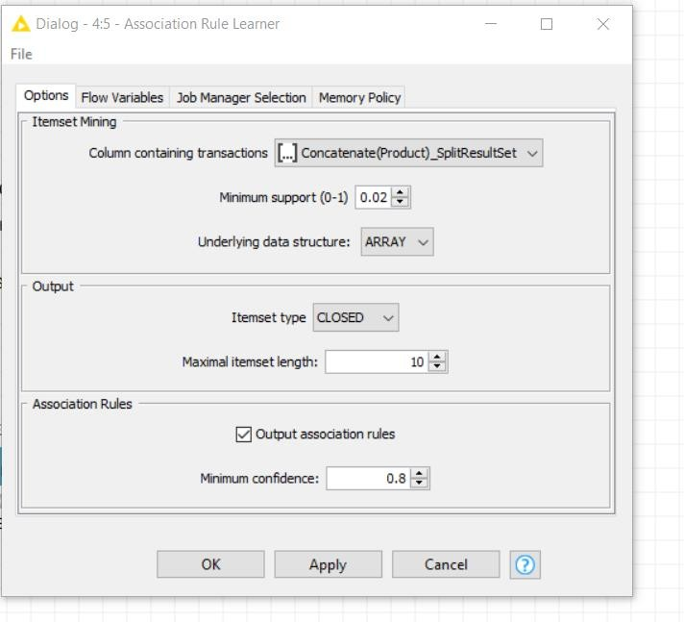
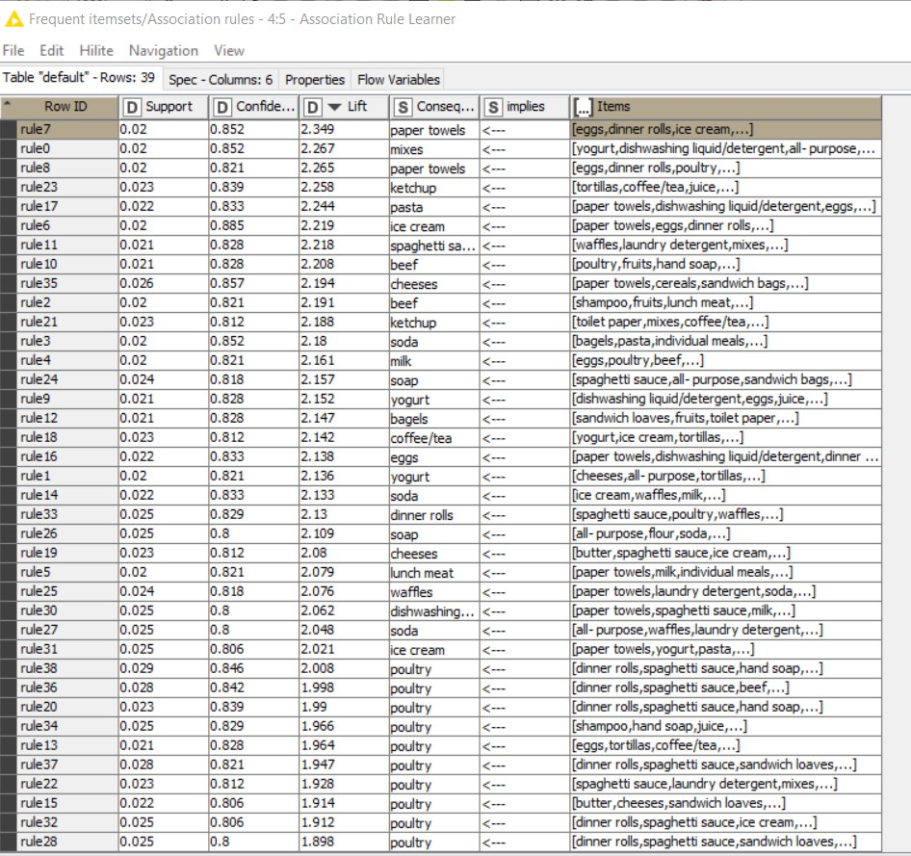
MARKET BASKET ANALYSIS (ASSOCIATION RULES)
THRESHOLD VALUES
SUPPORT: 2% AND CONFIDENCE: 80%, WE COULD GET 39 PATTERNS OR BASKETS WITH LIFT 2.349 ITEMS

Slide 22

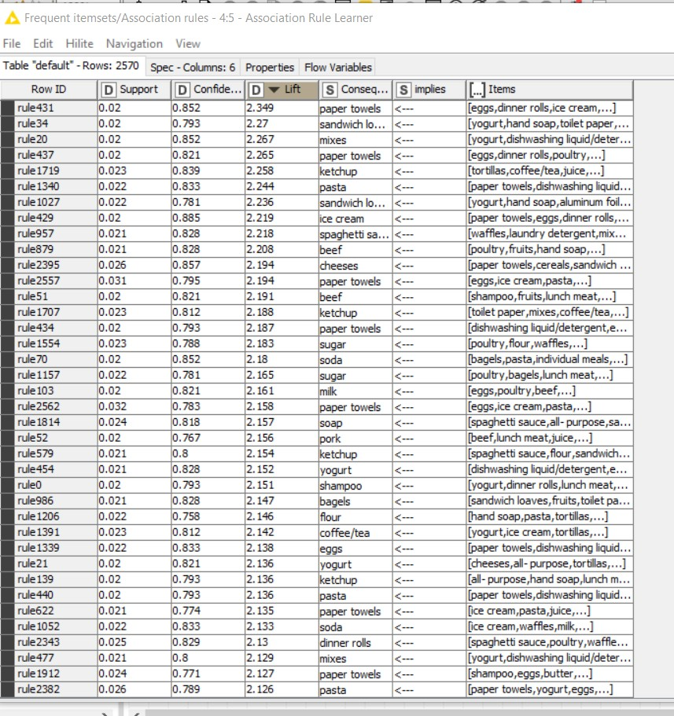
MARKET BASKET ANALYSIS (ASSOCIATION RULES)
THRESHOLD VALUES
SUPPORT: 2% AND CONFIDENCE: 70%, WE COULD GET 2570 PATTERNS OR BASKETS WITH LIFT 2.394 ITEMS

Slide 23
Associations Identified
→Put the associations in a tabular manner
→ Explain about support, confidence, & lift values that are calculated

Slide 24
KNIME WORKFLOW IMAGE WITHOUT CREATING
PRODUCT ID’S
SUPPORT: 2% AND CONFIDENCE: 80%

Slide 25
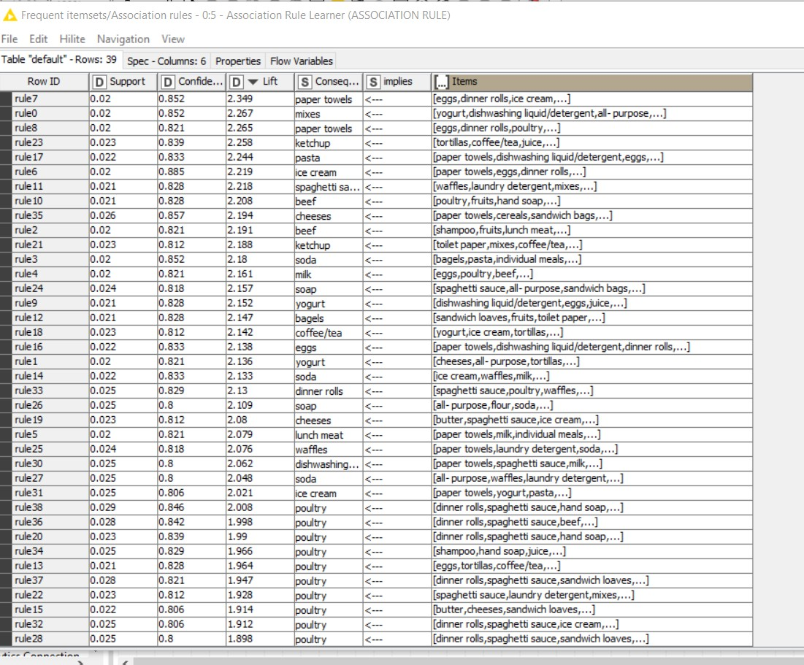
KNIME OUTPUT TABLE GENERATED WITHOUT PRODUCT ID’S

Slide 26
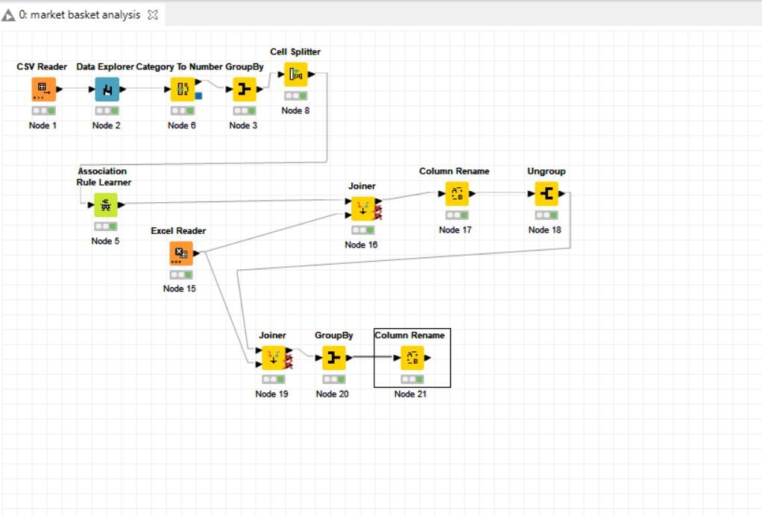
KNIME WORKFLOW IMAGE WITHOUT CREATING
PRODUCT ID’S
SUPPORT: 2% AND CONFIDENCE: 80%

Slide 27
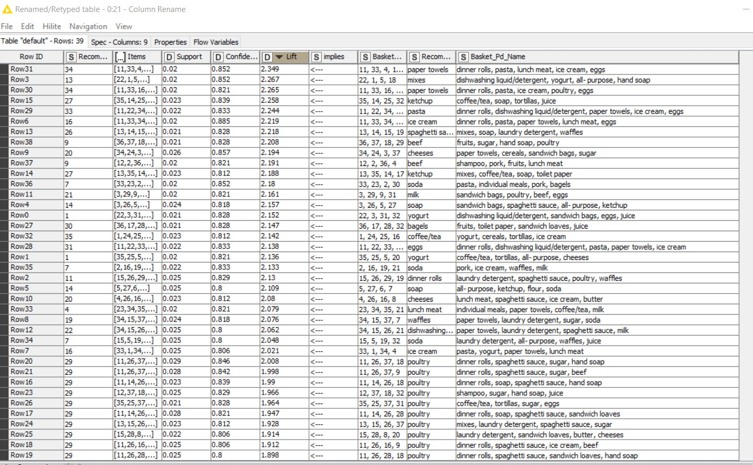
KNIME OUTPUT TABLE WITH PRODUCT RECOMMENDATION

Slide 28
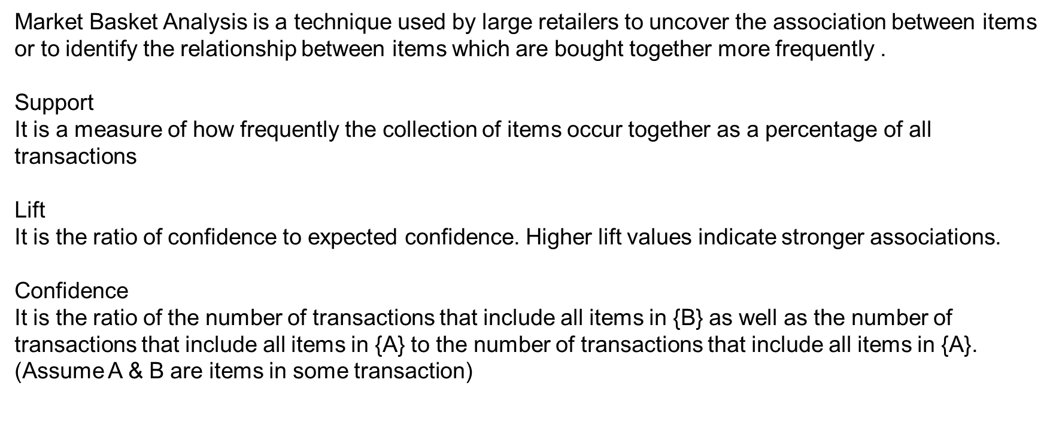
TERMS USED IN MARKET BASKET ANALYSIS
It is calculated by dividing probability of items occurring together by probability of occurrence of antecedent.
Threshold of support and confidence are set by the users and are parameters of “Apriori” algorithm for association rule generation. These parameters exclude rules in the output having support or confidence lower than threshold support and threshold confidence, respectively.

Slide 29
OUTPUT TAKEN FROM KNIME TO EXPLAIN SUPPORT, CONFIDENCE THRESHOLDS AND LIFT
Support | Confidence | Lift | Consequent | implies | Items
0.020193 | 0.851851852 | 2.349296027 | paper towels | <--- | [eggs, dinner rolls, ice cream, pasta, lunch meat]
In the above example,
The support value 0.20193> 0.2. Support is defined as ratio of P(occurrence of items + consequent) to P(items).
Here, the confidence value 0.8518 > 0.8. Confidence is the value that customers buy the consequent if the list of items are purchased.
Lift =2.34. This represents the increase in expectation that the product paper towels will be brought when this set of
items are purchased.
Here, the threshold of support = 0.02 or 2%. Threshold value of confidence is 0.8 or 80%

Slide 30
Suggestion of Possible Combos with Lucrative Offers
→ Write recommendations
→ Make discount offers or combos (or buy two get one free) based on the associations and your experience

Slide 31
RECOMMENDATIONS
TABLE SHOWING ASSOCIATIONS HAVING HIGHEST LIFT
Support | Confidence | Lift | Consequent | implies | Items
0.020193 | 0.851851852 | 2.349296027 | paper towels | <--- | [eggs, dinner rolls, ice cream, pasta, lunch meat]
0.020193 | 0.851851852 | 2.266960886 | mixes | <--- | [yogurt, dishwashing liquid/detergent, all- purpose, hand soap]
0.020193 | 0.821428571 | 2.265392598 | paper towels | <--- | [eggs, dinner rolls, poultry, ice cream, pasta]
0.022827 | 0.838709677 | 2.258369557 | ketchup | <--- | [tortillas, coffee/tea, juice, soap]
0.021949 | 0.833333333 | 2.243892829 | pasta | <--- | [paper towels, dishwashing liquid/detergent, eggs, dinner rolls, ice cream]
0.020193 | 0.884615385 | 2.21933243 | ice cream | <--- | [paper towels, eggs, dinner rolls, pasta, lunch meat]
0.021071 | 0.827586207 | 2.217931034 | spaghetti sauce | <--- | [waffles, laundry detergent, mixes, soap]
0.021071 | 0.827586207 | 2.207542599 | beef | <--- | [poultry, fruits, hand soap, sugar]
SUPPORT: 2% AND CONFIDENCE: 80%, WE COULD GET 39 PATTERNS OR BASKETS WITH LIFT 2.349 ITEMS

Slide 32
RECOMMENDATIONS OF BEST COMBOS
Consequent | implies | Items
paper towels | <--- | [eggs, dinner rolls, ice cream, pasta, lunch meat]
mixes | <--- | [yogurt, dishwashing liquid/detergent, all- purpose, hand soap]
paper towels | <--- | [eggs, dinner rolls, poultry, ice cream, pasta]
ketchup | <--- | [tortillas, coffee/tea, juice, soap]
pasta | <--- | [paper towels, dishwashing liquid/detergent, eggs, dinner rolls, ice cream]
ice cream | <--- | [paper towels, eggs, dinner rolls, pasta, lunch meat]
spaghetti sauce | <--- | [waffles, laundry detergent, mixes, soap]
beef | <--- | [poultry, fruits, hand soap, sugar]
FOR THE ABOVE ITEMS THE MENTIONED CONSEQUENT AGAINST IT CAN BE GIVEN
AS COMBO

Slide 33
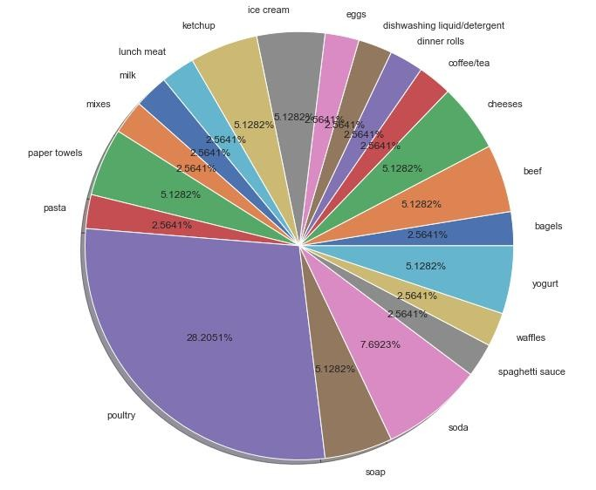
The pie chart depicts the frequency of recommended product (consequent) against different items
With highest percentage of for Poultry (28.20%).
PERCENT FREQUENCY OF CONSEQUENT (RECOMMENDED PRODUCT) USING ASSOCIATION RULES
It is recommended to increase the cost of poultry.
Plots generated in python jupyter notebook after reading the csv files and importing libraries pandas, matplotlib and seaborn

Slide 34
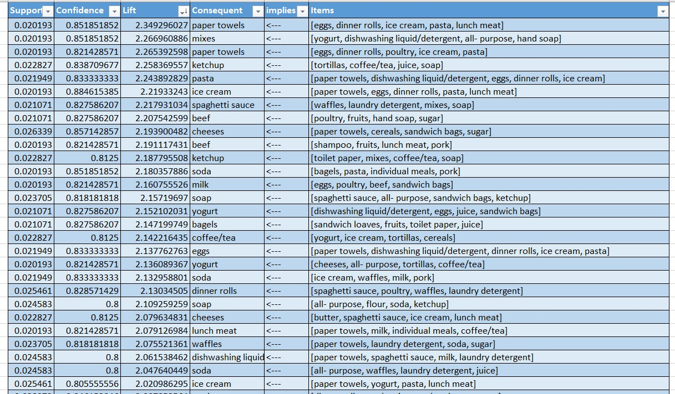
RECOMMENDATIONS FOR DISCOUNTS AND OFFERS
The products under consequent column having Lift > 2.1 and repeated multiple times can be considered for discounted price, viz., paper towels, etc.
The products under consequent column having Lift > 2.1 and mentioned only once can be considered for offers like “Buy 2 get 1 free”- viz., bagels, spaghetti sauce etc.

Slide 35
CONCLUSIONS
Data set consists of three column varibles viz., Date, Order_id and Product with 20640 rows apart from header. There are 1139 orders transacted on 603 unique dates for 37 different products.
It is observed that sales are maximum in 2019 and sales drop drastically by 2020. So, market basket
analysis of data may provide recommendations for higher profits.
Support: 2% and confidence: 80%, we could get 39 patterns or baskets with highest lift 2.349.
Paper towels can be placed for combo offer as it is often purchased with many items.
It is recommended to increase the cost of poultry as it has highest frequency under consequent (recommended product).
The products under consequent column having Lift > 2.1 and repeated multiple times can be considered for discounted price, viz., paper towels, etc.
The products under consequent column having Lift > 2.1 and mentioned only once can be
considered for offers like “Buy 2 get 1 free”-viz., bagels, spaghetti sauce etc.

